Slide 1
CAPSTONE PROJECT
Train ticket booking
Presented By:
Student Name: P ALEXANDRA SUSAN (2021303007)
College Name: ANNA UNIVERSITY, CHENNAI
Department: BTECH CHEMICAL ENGINEERING

Slide 2
OUTLINE
Problem Statement
Proposed System/Solution
System Development Approach
Algorithm & Deployment
Result
Conclusion
Future Scope
References

Slide 3
PROBLEM STATEMENT
To develop an automated movie ticket booking system that offers users a seamless and convenient way to browse available movies, select preferred seats, and complete bookings online. By addressing these challenges, the system aims to enhance the overall movie-going experience for customers while streamlining the ticket booking process for theater operators.
With this problem statement in mind, we can proceed to propose solutions and outline the system approach for developing the movie ticket booking system.

Slide 4
PROPOSED SOLUTION
The program should handle various scenarios such as:-
Ensuring that seats are not double-booked.
Providing real-time updates on seat availability.
Handling payment transactions securely.
Allowing users to select specific seats or letting the system assign seats automatically.
Providing a user-friendly interface for seamless booking experience.
Key Features:
User authentication and authorization.
Integration with payment gateways for secure transactions.
Real-time updates on seat availability and showtimes
Support for different ticket types and pricing.
Automated email confirmations for bookings and cancellations.

Slide 5
SYSTEM APPROACH
Technologies Used:
Python programming language for backend development.
GUI framework like Tkinter or PyQt for frontend interface.
SQLite or MySQL for database management.
GitHub for version control and collaboration.

Slide 6
ALGORITHM & DEPLOYMENT
Algorithm:
Movie Selection:
Users browse available movies and select their preferred movie from the list.
Seat Selection:
After selecting a movie, users choose the number of tickets they want to book and select their preferred seats from the seating layout displayed on the interface.
Seat Availability Check:
Before confirming the booking, the system checks the availability of selected seats to prevent overbooking and ensure a seamless experience for users.
Booking Confirmation:
Once seat availability is confirmed, users proceed to the payment stage where they provide necessary details and complete the booking.
Transaction Processing:
The system processes the transaction securely, deducting the cost of tickets from the user’s account and updating the seat availability accordingly.

Slide 7
ALGORITHM & DEPLOYMENT
Booking Confirmation:
Finally, the system generates a booking confirmation receipt for the user, which includes details such as movie name, showtime, seat numbers, and transaction ID.
Server-Side Development:
• Develop the backend of the system using Python, Django, or Flask frameworks to handle user requests, manage data, and process transactions securely.
Database Management:
Use a database management system (e.g., MySQL, PostgreSQL) to store movie details, seat availability, user information, and transaction records.
Front-End Development:
Develop the front-end of the system using HTML, CSS, and JavaScript to create a user-friendly interface for browsing movies, selecting seats, and completing bookings.

Slide 8
ALGORITHM & DEPLOYMENT
Hosting Platform:
Choose a reliable hosting platform (e.g., AWS, Heroku) to deploy the application and ensure its accessibility to users from different locations.
Security Measures:
Implement security measures such as HTTPS encryption, user authentication, and secure payment gateways to protect user data and transactions from unauthorized access.
Continuous Monitoring and Updates:
Monitor the system regularly for performance issues, security vulnerabilities, and user feedback, and deploy updates as needed to improve functionality and address any issues.

Slide 9
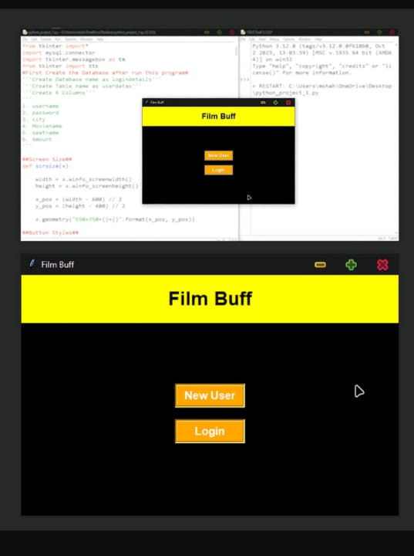
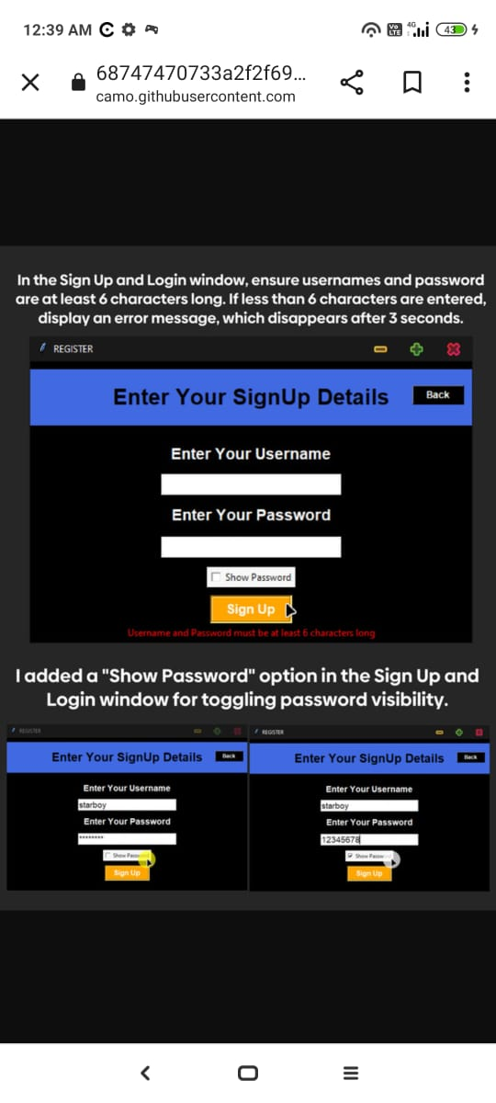
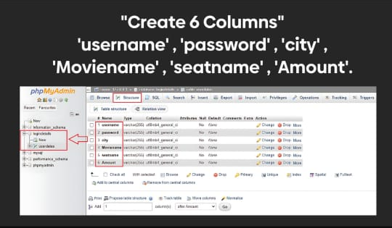
RESULT
1
2
3

Slide 10
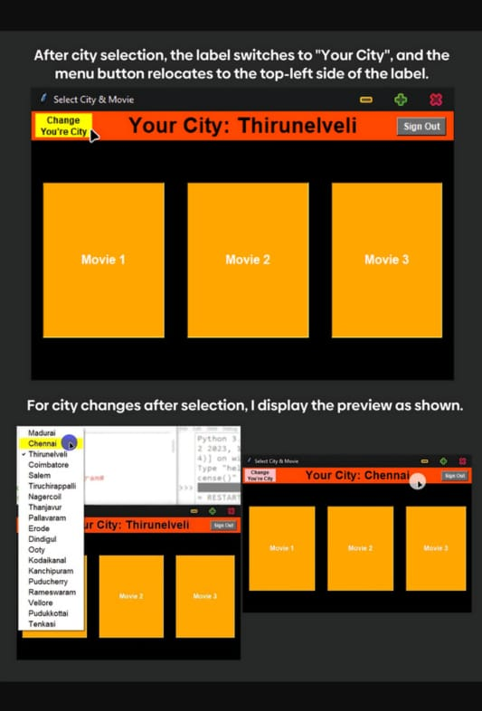
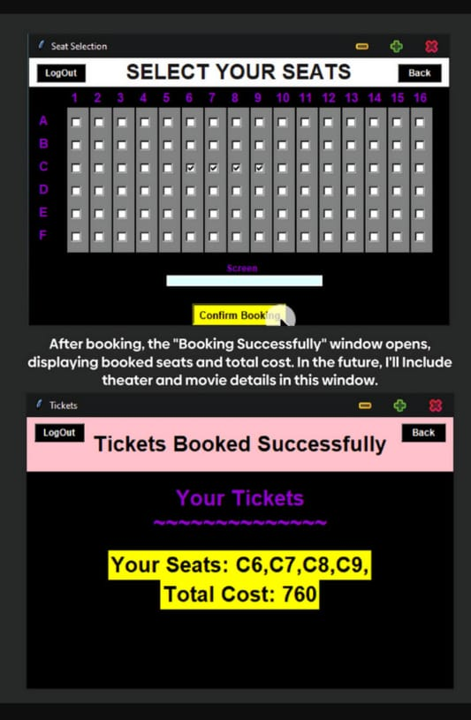
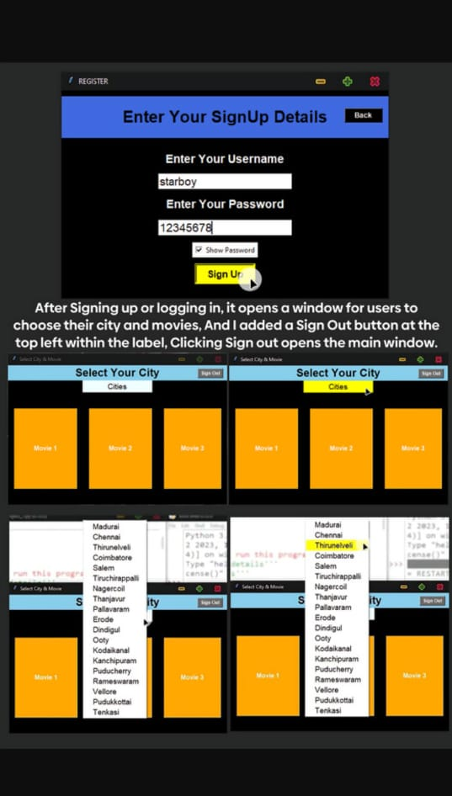
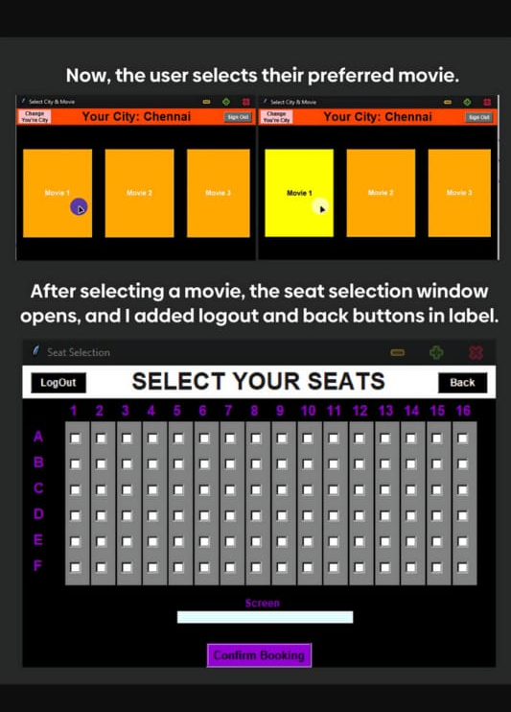
RESULT
7
5
4
6

Slide 11
CONCLUSION
The development and deployment of the movie ticket booking system have been successful in addressing the inefficiencies of traditional ticket booking methods. By leveraging technology, we’ve created a user-friendly platform that streamlines the booking process and enhances the overall movie-going experience for customers. The system’s efficient seat management and transaction tracking capabilities contribute to its effectiveness in meeting user demands and generating revenue for theater operator

Slide 12
FUTURE SCOPE
Enhanced User Features:
Implement user accounts and profiles for personalized recommendations, booking history, and loyalty rewards.
Integrate social media platforms for sharing movie choices and inviting friends to join bookings.
Advanced Seat Allocation Algorithms:
Develop smarter algorithms for seat allocation, considering factors such as group bookings, seat preferences, and optimizing theater occupancy.
Integration with External Services:
Integrate with movie review aggregators to provide users with ratings and reviews for each movie.
Partner with food delivery services to offer movie-themed food and beverage options for online ordering during booking.
Expansion to Other Platforms:
Develop mobile applications for iOS and Android devices to reach a wider audience and provide on-the-go booking convenience.
Continuous Improvement and Feedback:
Gather user feedback regularly to identify areas for improvement and implement updates to enhance the system’s functionality and user experience

Slide 13
REFERENCES
G. Aggarwal, N. Sharma, and R. Kapoor, “Optimization Techniques for Seat Allocation in Online hotel Booking Systems,” International Journal of Computer Applications, vol. 182, no. 12, 2018
“ Building Scalable Web Architecture and Distributed Systems” by AWS: https://aws.amazon.com/architecture/
“The Evolution of Online Ticketing Systems: Case Studies and Trends” by Ticketmaster: https://www.ticketmaster.com/

Slide 14
THANK YOU

